Slide 1


How ChatGPT is Killing Q&A Sites
Created by:
Ibrahim Qahtan
Mustafa Musab
Abdulazeez Qusay
Kozhin Kamal
Supervisor:
DR.Nawin Najat

Slide 2
TABLE OF CONTENTS
01
The Rise of Stack Overflow
03
The Future of Q&A Sites
02
The Fall of Stack Overflow

Slide 3
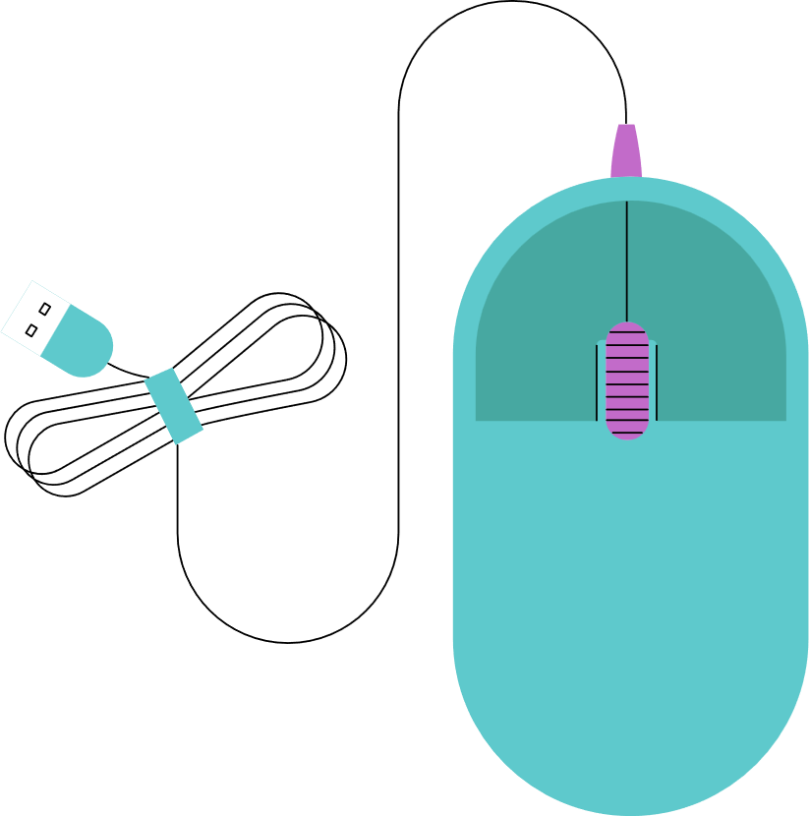
01
Defining the Research Problem
Caption: Our research journey begins with a compelling observation: the apparent shift in the Q&A landscape. For years, Stack Overflow reigned supreme as the go-to platform for developers seeking solutions. However, the emergence of sophisticated AI like ChatGPT presents a potential disruption.
Research Problem: Is ChatGPT significantly impacting user engagement and activity on Stack Overflow, potentially leading to its decline as the dominant platform for programming-related questions and answers?

Slide 4

02
The Research Process and Steps
Decline in activity:
Users report fewer responses to questions.
Duplicate questions and outdated answers pile up.
Competition from AI:
ChatGPT provides instant, personalized answers without wait times.
AI avoids "gatekeeping" (e.g., downvotes for beginner questions).
Traffic drop: Stack Overflow's 2023 report shows a ~30% decline in visits.

Slide 5
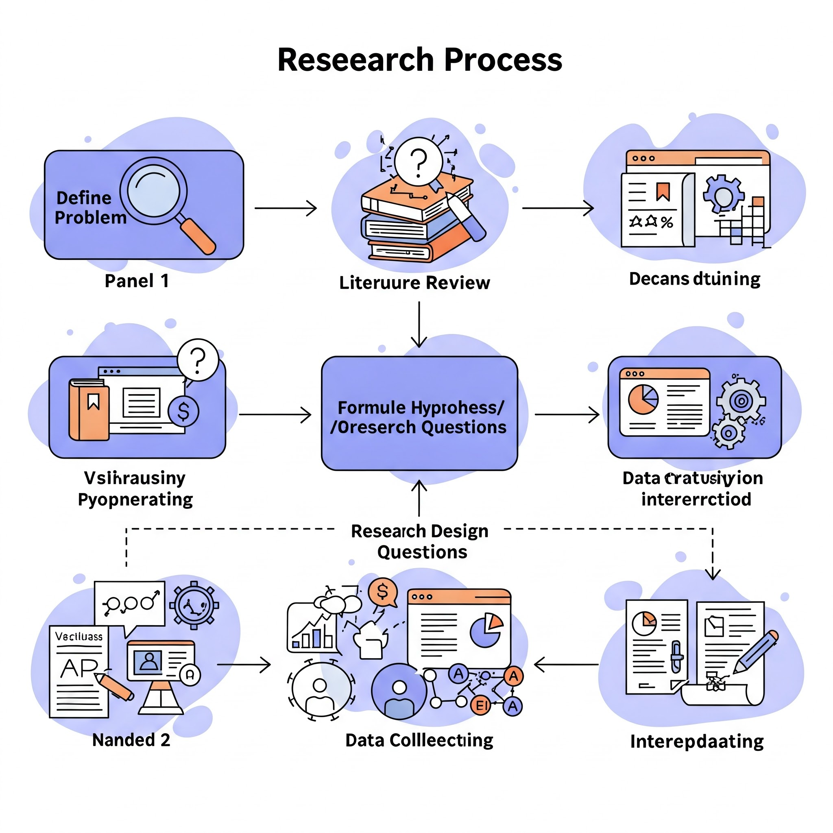
02
The Research Process and Steps

Slide 6

03
The Future of Q&A Sites
Adapt or perish: Q&A sites must integrate AI (e.g., Stack Overflow's "Overflow AI" initiative).
Human + AI synergy:
AI handles quick answers; humans curate nuanced discussions.
Platforms could focus on community-building beyond Q&A.
Final thought: ChatGPT isn't killing Q&A—it's forcing evolution.

Slide 7


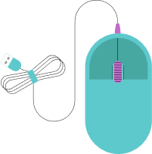














RESOURCE PAGE
What is Vibe Coding? From IBM https://stackoverflow.com/questions
2.blog.replit.com
https://www.similarweb.com/corp/ourdata/
3.tiiny.host
https://www.purdue.edu/newsroom/2023/Q3/chatgpt-outperforms-stack-overflow-in-coding-answers-study-finds/

Slide 8

THANK YOU!

